Slide 1
True or False: Vaccines have saved more human lives than any other medical invention in history?
Audience Participation
Notes:
https://app.wooclap.com/events/UPNAFG/0
Since my typical audience is 18-24 year-olds, and the best way to ensure they aren’t sleeping through class is to give them an excuse to use their phones, we’re going to try some audience participation to kick off the lunch/keynote session.

Slide 3
What is the top response you receive from patients/community on the topic of vaccination?
Audience Participation
Notes:
https://app.wooclap.com/events/UPNAFG/0
Now, let’s take a moment to gauge community perceptions. I want to know, when you bring up the topic of vaccination, how do people respond?

Slide 4
Vaccine Hesitancy: From Past to Present
Elizabeth Gordon, PhD, MPH, CPH

Slide 5
In 2019, the World Health Organization (WHO) identified vaccine hesitancy as one of its top ten threats to global health.
Notes:
We can see from our responses here today that there are a lot of people who are hesitant, or dare I say opposed, to vaccination. In the age of social media, this is no secret!
But this vaccine hesitancy, it’s a real public health challenge. Even before COVID-19 brought the topic of vaccination to the forefront of the public agenda, the World Health Organization named vaccine hesitancy one of the top 10 global health threats in 2019.
Vaccine hesitancy – it’s the reluctance or refusal to vaccinate despite the availability of vaccines, and this hesitancy threatens to reverse progress made in tackling vaccine-preventable diseases. Measles, for example, has seen a 30% increase in cases globally. Not all of this is due to vaccine hesitancy, but it definitely plays a part.

Slide 6
Vaccine Hesitancy Today
Top Reasons for Hesitancy
Individual Characteristics
Complacency
Inconvenient to Access
Lack of Confidence
Younger Adults
Lower Educational Attainment
Reside in Rural County
Notes:
The reasons why people choose not to vaccinate are complex; a vaccines advisory group to WHO identified complacency, inconvenience in accessing vaccines, and lack of confidence as key reasons underlying hesitancy.
If you look at the academic literature, it’s full of articles describing the characteristics of those individuals that are more likely to be vaccine hesitant: younger adults, those with HS education or less, residing in a rural county.

Slide 7
A History of Controversy!
Notes:
We’ve heard a lot about current data today, and we’ll end with some resources to guide us. But, I tell my students all the time that we can better understand current issues, if we take a look at the history, how did certain problems or perspectives or disparities come about. So today, I want to tell you a story. A journey, really, that we humans, have been on as we’ve tried to protect ourselves from deadly diseases. Along the way, we’ve made some monumental advancements, but also some questionable choices; we’ve involved, Kings, prisoners, milkmaids, and created no short supply of controversy and polarization in our wake.

Slide 8
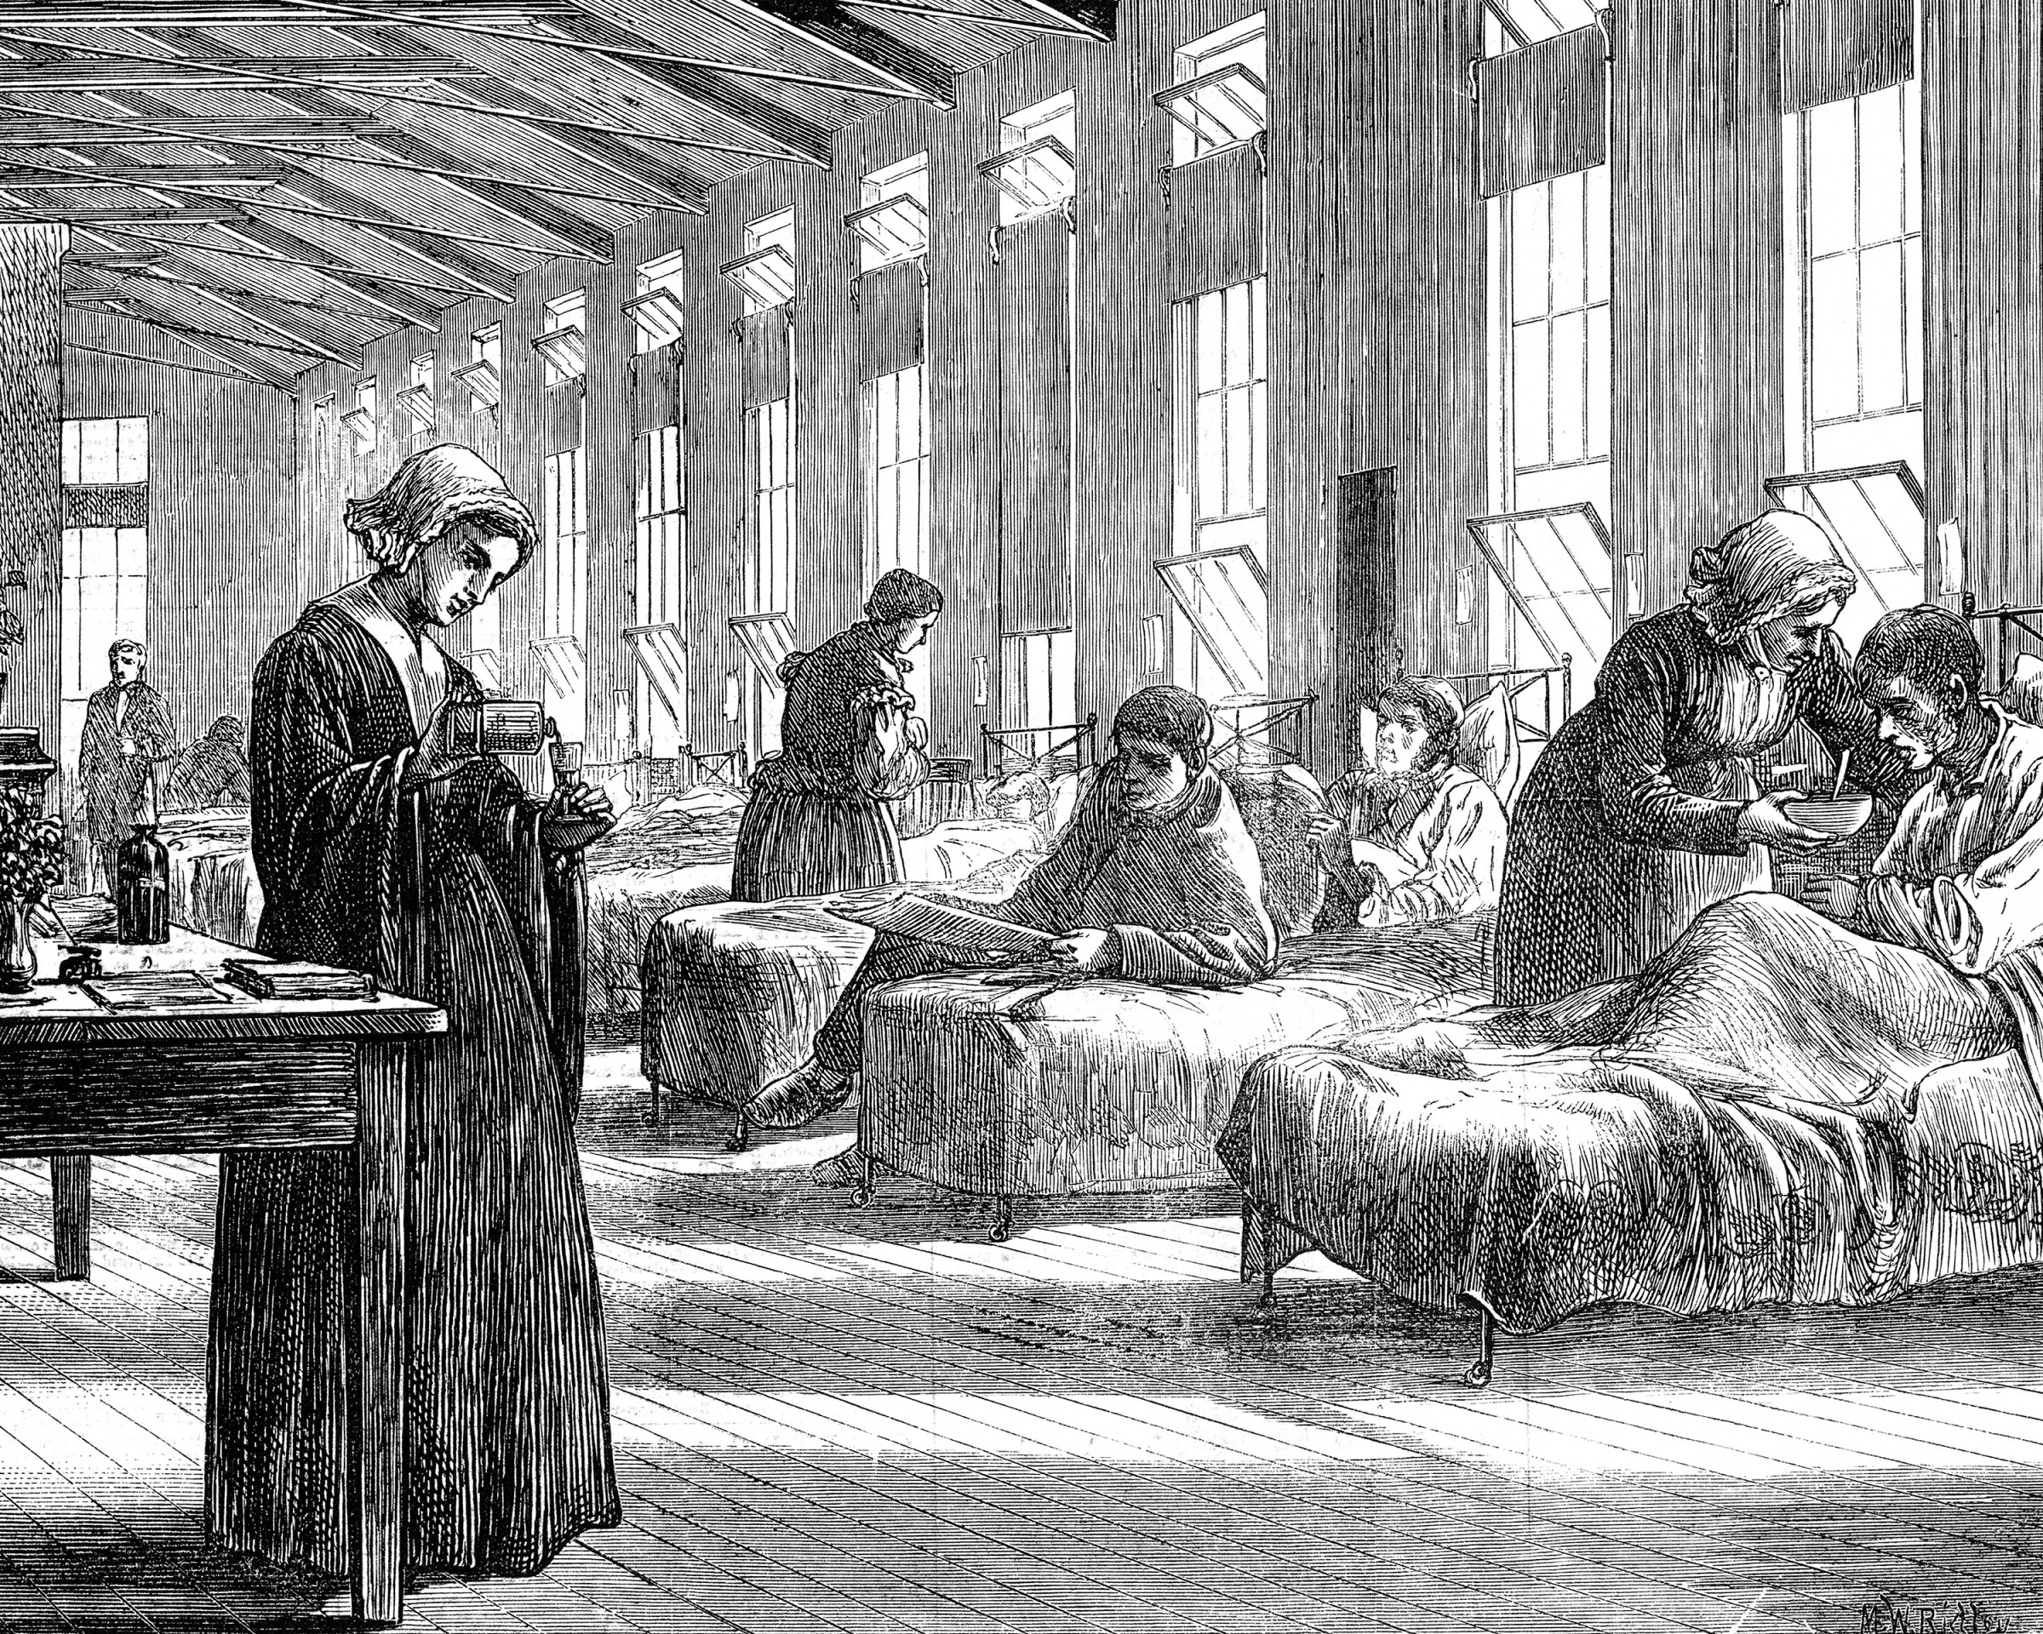
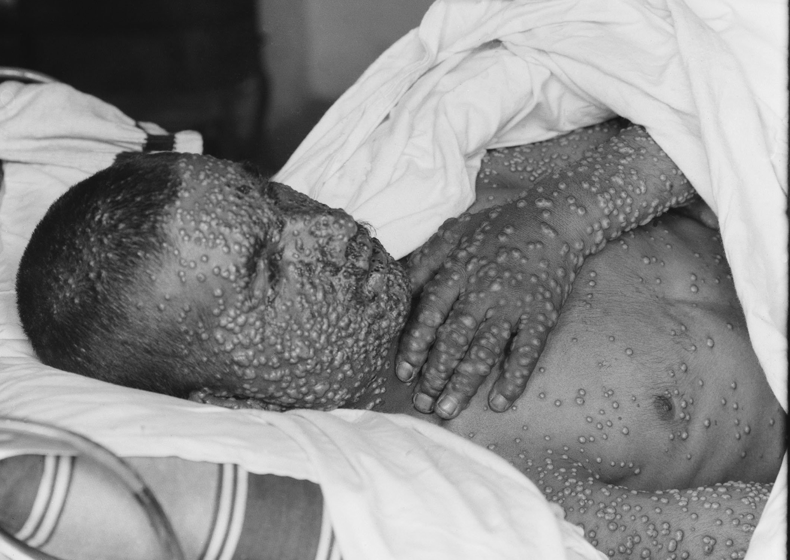
Smallpox
In the 1700s, 400,000 people died each year in Europe from smallpox
Smallpox survivors were severely scarred and frequently left blind
Smallpox became endemic in cities, while epidemics continued in smaller locales
Notes:
We’ll start our tale with smallpox. Smallpox has been plaguing humans around the globe for centuries. It was noted in China in the 10th century, in England, in the late 1400s, it was given the name smallpox to distinguish it from syphilis (known as great pockes). It was spread to the new World in the 1500s, decimating native populations in North and South America.
In the 1700s, 400,000 people died each year in Europe from smallpox; survivors were severely scarred and frequently left blind. At that time it was estimated to kill 80-90% of infants and 20-60% of adults. This disease alone killed millions of people around the world.
In larger cities, such as London and Paris, smallpox became endemic and never went away, whereas in smaller locales epidemics continued

Slide 9
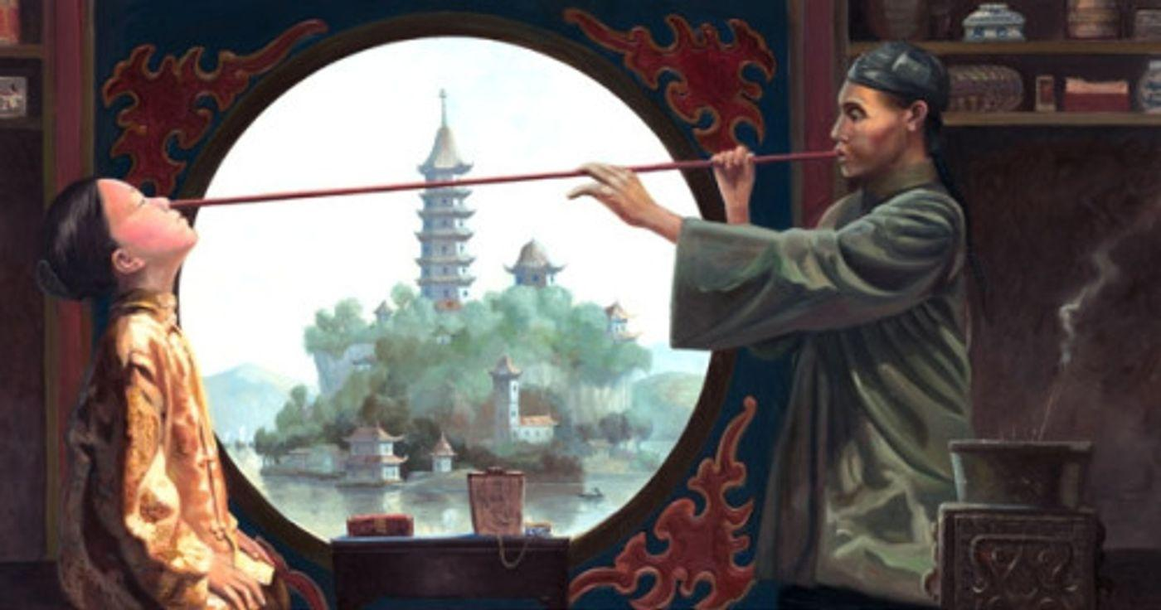
Early Smallpox Prevention
Smallpox prevention started in China when material from the sores was put into individuals’ noses
Inoculations (from the Latin word innoculare, “to graft”) were also called variolation
Using a needle or other sharp object, material from smallpox sores from an infected person was injected under a healthy person’s skin
Notes:
We now know that the Variola virus causes smallpox in humans, the only reservoir spreading the disease from person to person. Infection spreads through expired respiratory air or respiratory droplets or close contact between infectious virus material in the sores.
Let’s look at some of the early techniques for preventing smallpox.
Records indicate smallpox prevention may have started in China in the 10th century when material from the sores was put into individuals’ noses in an attempt to produce immunity.
Inoculations (from the Latin word innoculare, “to graft”) were also called variolation
Using a needle or other sharp object, material from smallpox sores from an infected person was injected under a healthy person’s skin
There’s also records that indicate smallpox prevention may have started in China in the 10th century when material from the sores was put into individuals’ noses in an attempt to produce immunity.

Slide 10
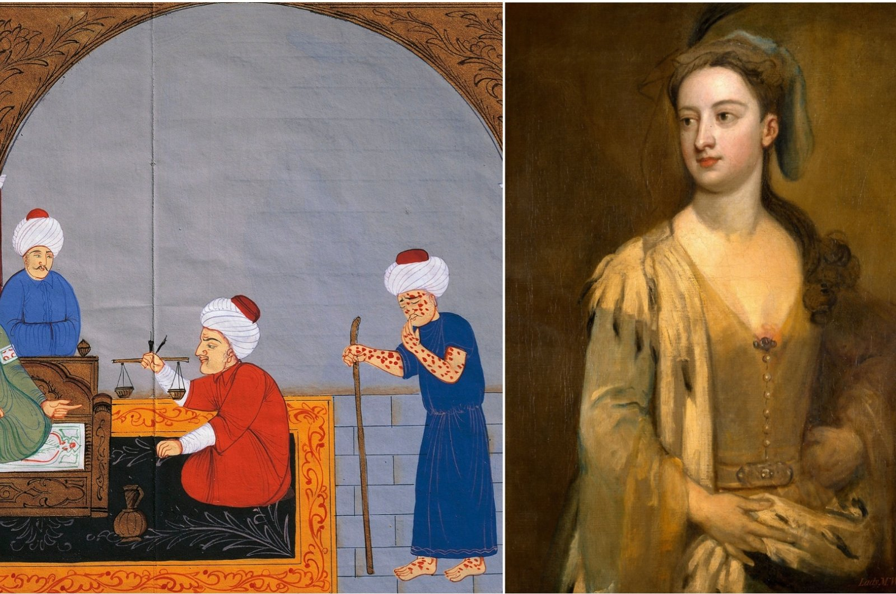
Variolation: Early Smallpox Prevention
Variolation was introduced to Europe from Turkey and promoted by royal families
Some believed it was “tantamount to murder to infect children with smallpox”
Early experiments conducted on prisoners, orphans, and even the Princess of Wales’ children
Notes:
Variolation was introduced to Europe from Turkey. In the early 1700s, a physician saw the practice performed and wrote to the Royal Society of London. And, that might have been the end of the story, at least at that time. But, Lady Mary Wortley Montagu, the wife of an English ambassador, who herself was a smallpox survivor with facial scars, observed variolation during her travels to Istanbul. Not wanting her children to suffer the same fate, in 1718, she had them inoculated. Her advocacy to the British medical establishment contributed to variolation’s growth in England. But, not all physicians were in favor of the practice, one saying it was tantamount to murder to infect children with smallpox. But, the embassy surgeon who inoculated Lady Mary’s children received the King’s approval to use variolation on six prisoners; all of which survived, and following exposure to smallpox, were immune. Similar trials were successfully repeated on orphans and the daughters of the Princess of Wales in 1722.
The data suggested that 2-3% of variolated people died of smallpox, sometimes starting new outbreaks. Communities were left to weight these risks against the risks of the disease itself. Variolation saw less support in the “new World” with religious leaders and the medical establishment convincing the Boston governance to outlaw this procedure.
In the midst of intense polarization about the effectiveness and risks, the practice continued across Europe and New England in the 1700s. The promotion by royal families contributed to variolation spreading more widely across Europe.

Slide 11
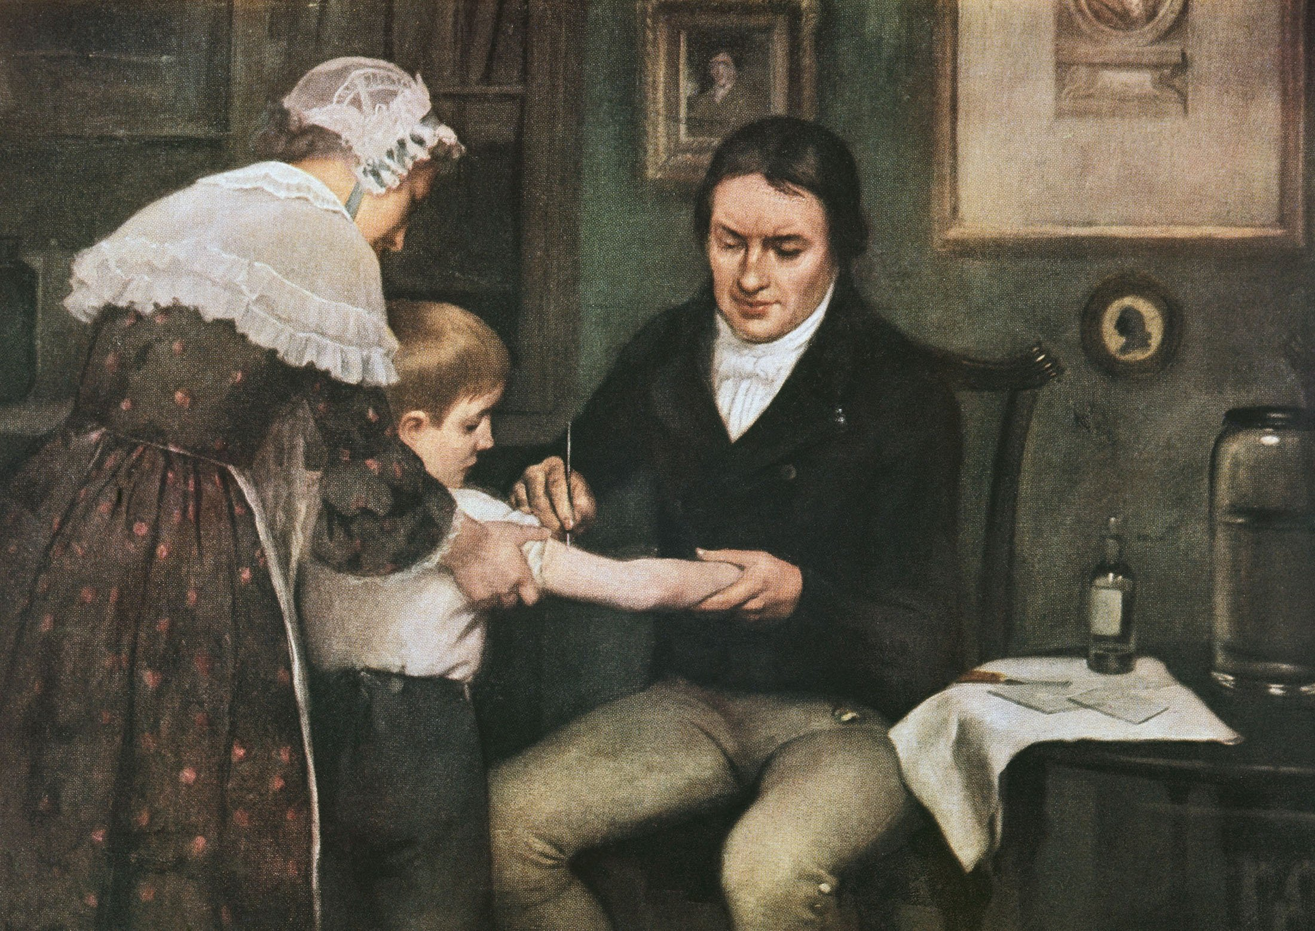
Variolation to Vaccination
An English physician named Edward Jenner noticed that people who recovered from cowpox did not get smallpox
In spring 1796, Sarah Nelmes, a milkmaid near his practice developed cowpox
Using material from one of the pustules on Sarah’s hand, Jenner inoculated James Phipps, an 8-year-old boy, on May 14, 1796; the boy suffered a mild illness but recovered fully
Notes:
An English physician named Edward Jenner tried a new approach. Jenner noticed that people who recovered from cowpox did not get smallpox. Cowpox was usually a benign disease contracted in people working with cows by direct contact with cow pustules. Jenner collected evidence recording examples of people who were infected with cowpox and later resistant to smallpox.
Despite this evidence, his colleagues were still reluctant to the idea. So, he devised a way to test the idea.
In spring 1796, Sarah Nelmes, a milkmaid near his practice developed cowpox.
Using material from one of the pustules on Sarah’s hand, he inoculated James Phipps, an 8-year-old boy, on May 14, 1796; the boy suffered a mild illness but recovered fully.

Slide 12
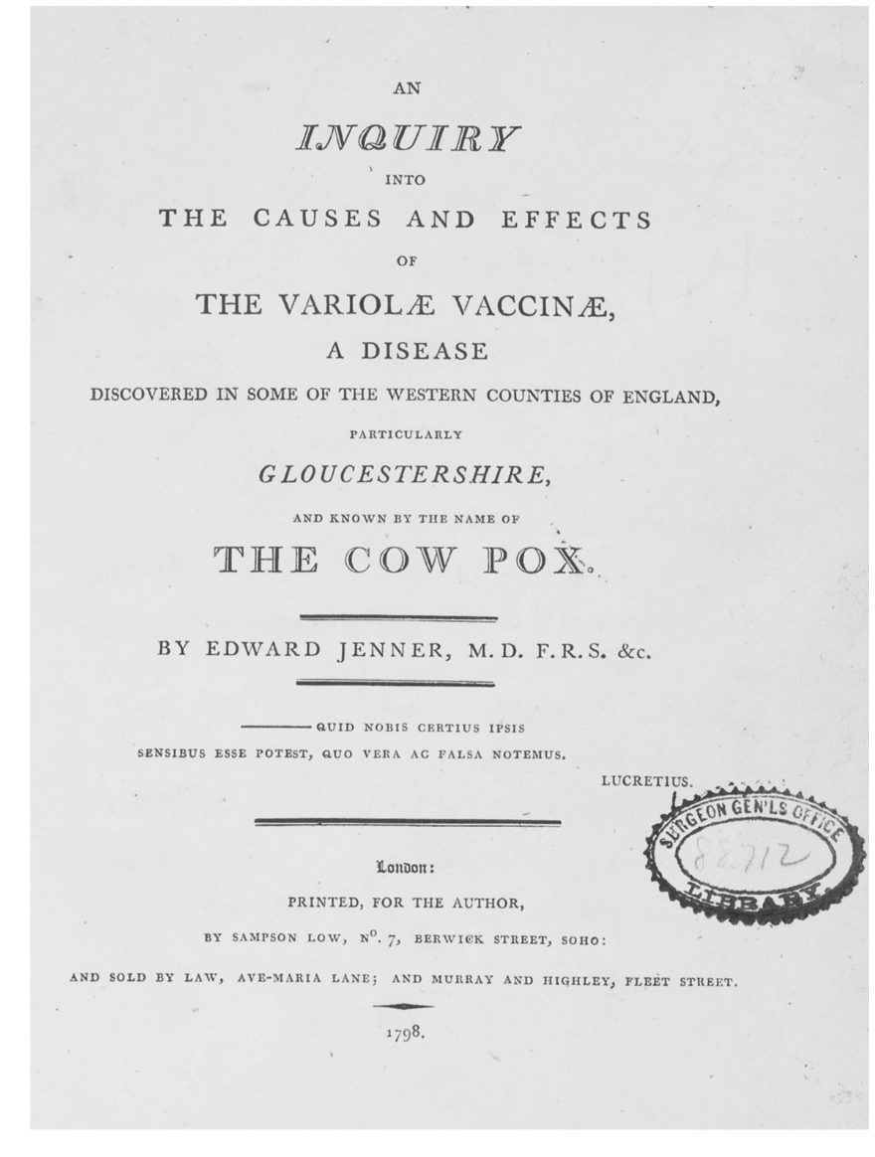
Variolation to Vaccination
On July 1, Jenner inoculated the same young boy with smallpox, and the boy remained healthy
On later repeat inoculation, the boy remained healthy
Jenner published multiple papers providing evidence of the effectiveness of vaccination for smallpox
Notes:
On July 1, Jenner inoculated the same young boy with smallpox, and the boy remained healthy. On later repeat inoculation a few months later, the boy still remained healthy.
Jenner continued his work and published more papers providing evidence of the effectiveness of vaccination against smallpox. By 1800, he had inoculated over 6,000 people, and subsequently inoculated most of them with smallpox (he noted in every rational way that could be devised) to no effect.

Slide 13
Vaccine Controversy
Reactions to the new inoculations ranged from enthusiasm to vehement disagreement by the medical establishment, religious leaders, and the public
Political cartoons captured public and medical reluctance to accept the notion of vaccinations related to cow disease
Notes:
Reactions to the new inoculations ranged from enthusiasm to vehement disagreement by the medical establishment, religious leaders, and the public.
Two physicians at the London Smallpox and Inoculation Hospital were successfully replicating Jenner’s results. But, when some children at the hospital became infected with smallpox (attributed to contamination with natural smallpox during the procedure), this fanned the flames of detractors.
There were also financial repercussions for physicians. Practitioners who used variolation, the prevailing practice before Jenner’s vaccination, lost a vital income source.
Another prominent physician at the time pondered whether, “immunization with cowpox would result in the acquisition of animal characteristics.”
Political cartoons, like that shown here, captured public and medical reluctance to accept the notion of vaccinations related to cow disease.

Slide 14
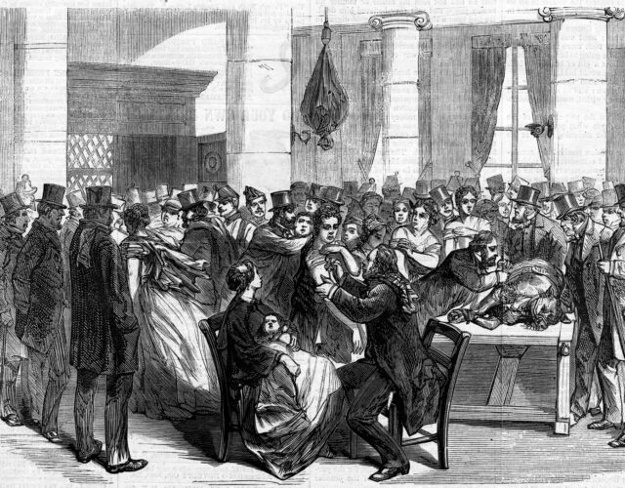
Moving towards Acceptance
By the mid-1800s, vaccination was free and available to the public in Britain
Smallpox vaccination became the first vaccine mandate
Notes:
Jenner wrote many additional papers into the early 1800s, and despite the debates, smallpox vaccination spread across Europe and around the globe. By 1808, Jenner helped create the National Vaccine Establishment with support from Parliament.
By the mid-1800s vaccination was free and available to the public in Britain.
Another act made vaccination required for children by 3 months of age. So, the first vaccine mandate.

Slide 15
Vaccination: An Enduring Public Health Impact
Jenner’s advocacy led to widespread vaccination use worldwide
U.S. President Thomas Jefferson and France’s Napoleon recognized Jenner’s work
Jenner’s work with vaccination “began the long process which resulted in the successful eradication of the smallpox virus in 1980”
Notes:
Jenner’s advocacy led to widespread vaccination use worldwide
U.S. President Thomas Jefferson, in a letter to Jenner, wrote, “Medicine has never before produced any single improvement of such utility…You have erased from the calendar of human afflications one of it’s greatest.” France’s Napoleon awarded Jenner a medal, even though England and France were at war.
Jenner’s work with vaccination “began the long process which resulted in the successful eradication of the smallpox virus in 1980”

Slide 16
Vaccination: An Enduring Public Health Impact
People have been vaccinated against deadly diseases for over two centuries
Vaccination is likely the world’s most studied medical technique
With vaccines, humanity has come a long way
In just the last 30 years, child deaths have declined by over 50%, thanks in large part to vaccines
Notes:
For over 2 centuries, people have been vaccinated against deadly diseases, ever since the world’s first vaccine was devised against smallpox. Vaccination is likely the world’s most studies medical technique.
From groundbreaking practices in the 1500s to the new technologies used in COVID-19 vaccines, we have come a long way. In just the last 30 years, child deaths have declined by over 50%, thanks in large part to vaccines. Returning to my first question to you, have vaccines saved more human lives than any other medical invention?

Slide 17
Vaccines have saved more human lives than any other medical invention in history
Notes:
Yes, it’s undeniable that vaccines have saved more human lives than any other medical invention in history. And, I would be shocked, if we came up with any other invention that surpasses vaccinations in lives save!

Slide 18
Vaccines are Safe, Effective, and SAVE LIVES!
Vaccinations save millions of lives every year!
Immunization currently prevents 3.5 million to 5 million deaths every year from diseases like diphtheria, tetanus, pertussis, influenza and measles
COVID-19 vaccinations prevented an estimated 14.4-19.8 million deaths globally
63% reduction in total COVID deaths globally
Vaccination is one of the most cost-effective ways of avoiding disease
Notes:
As we leave here today, let’s remember this fact. That lost in all the controversy, the polarization, the skepticism, people need to be reminded that vaccines have endured and advanced across the centuries because they are effective and because they save lives.
Immunization currently prevents 3.5 million to 5 million deaths every year from diseases like diphtheria, tetanus, pertussis, influenza and measles.
Based on reported COVID‐19 deaths, vaccinations prevented an estimated 14.4 million deaths from COVID‐19 in a year. However, if excess deaths were used, this estimate rose to 19.8 million (deaths prevented), equating to a global reduction of 63% in total deaths (19.8 million of 31.4 million) during the first year of COVID‐19 vaccination.
Not only that, but vaccination is one of the most cost-effective ways of avoiding disease.
While today, when compared to more impressive medical feats, vaccination can seem insignificant, mundane, routine, easy to discount or overlook, the fact remains that vaccinations save lives. And these data points, represent real people around that world.
The author from a COVID vaccination study looking at lives saved in the European region alone is quoted as saying, “Today, there are more than 1.4 million people in our Region – most of them elderly – enjoying life with their loved ones because they took the vital decision to be vaccinated against COVID-19. That’s nearly 1.5 million people who can play with their grandchildren, walk the dog, attend dance classes, volunteer and be active members of their communities. This is the power of vaccines.”
So, the evidence is clear. Vaccinations are safe, they are effective, they save lives. Yet, vaccine hesitancy is a constant battle (dating back to it’s inception, literally!).

Slide 19
Who is the top influencer of vaccination decisions?
Notes:
So, now that we have a better understanding of the back story of vaccines and the current data and trends and why hesitancy is such a problem, I’ll ask you one final question.
Who is the top influencer of vaccination decisions?

Slide 20
Who is the top influencer of vaccination decisions?
The answer is YOU!
Notes:
Who is the top influencer of vaccination decisions? The answer is you!

Slide 21
Health Workers Remain Trusted Advisor
Health workers, especially those in communities, remain the most trusted advisor and influencer of vaccination decisions
Estimates suggest that an additional 1.5 million deaths could be avoided if global coverage of vaccinations improved
Notes:
History has taught us that a full and effective global response to vaccine-preventable diseases takes time, financial support and collaboration – and requires continued vigilance
Health workers, especially those in communities, remain the most trusted advisor and influencer of vaccination decisions
Estimates suggest that an additional 1.5 million deaths could be avoided if global coverage of vaccinations improved.
I hope we all leave here today inspired by vaccines and ready to remain their trusted advocate among our community!

Slide 22
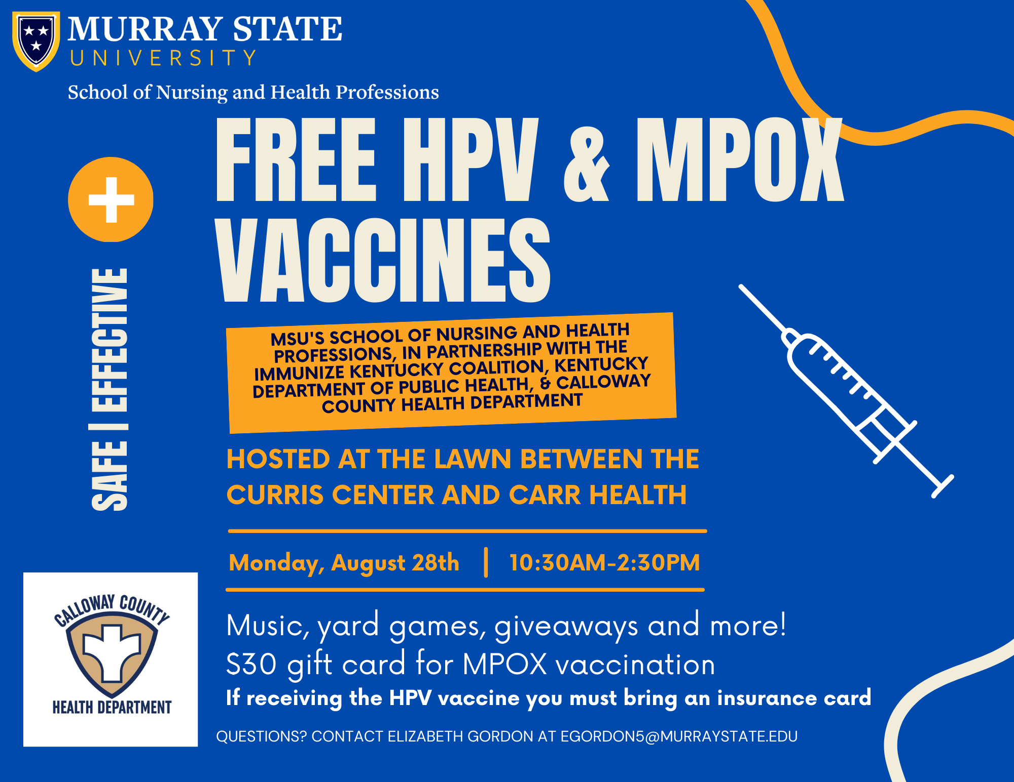

Slide 23
References
Carney, Jan (2023) A History of Public Health: From Past to Present. Jones & Bartlett Learning.
A brief history of vaccines (2024) World Health Organization. Retrieved from: https://www.who.int/news-room/spotlight/history-of-vaccination/a-brief-history-of-vaccination. 8/7/2024.
Ten threats to global health in 2019. (2019) World Health Organization. Retrieved from: https://www.who.int/news-room/spotlight/ten-threats-to-global-health-in-2019.
Lives saved by COVID‐19 vaccines. J Paediatr Child Health. 2022 Sep 20:10.1111/jpc.16213. doi: 10.1111/jpc.16213. PMCID: PMC9537923.
Estimated number of lives directly saved by COVID-19 vaccination programs in the WHO European Region, December 2020 to March 2023. The WHO European Respiratory Surveillance Network. medRxiv 2024.01.12.24301206; doi: https://doi.org/10.1101/2024.01.12.24301206

